Slide 1
Lecture10 Inheritance Casting and Run-time Type Identification & Operator Overloading
Qijun Zhao
College of Computer Science
Sichuan University
Spring 2023

Slide 2
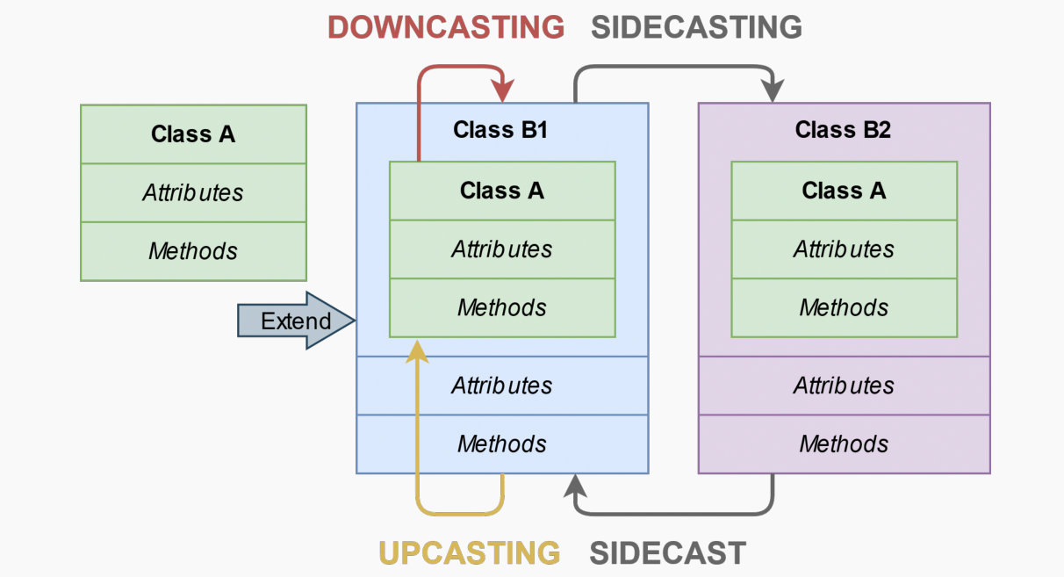
Hierarchy Casting
Class-casting allows implicit or explicit conversion of a class into another one across
its hierarchy

Slide 3
Hierarchy Casting
Upcasting Conversion between a derived class reference or pointer to a base class
- It can be implicit or explicit
- It is safe
- static_cast or dynamic_cast // see next slides
Downcasting Conversion between a base class reference or pointer to a derived class
- It is only explicit
- It can be dangerous
- static_cast or dynamic_cast
Sidecasting (Cross-cast) Conversion between a class reference or pointer to an other
class of the same hierarchy level
- It is only explicit
- It can be dangerous
- dynamic_cast

Slide 4
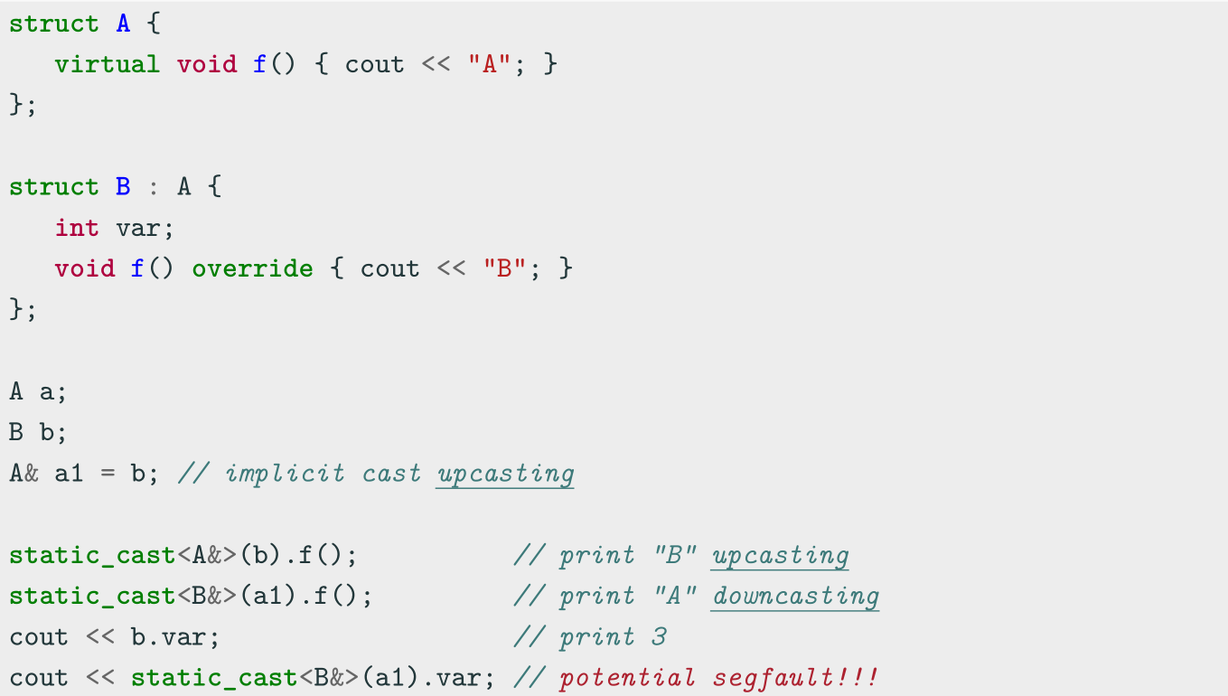
Upcasting and Downcasting Example

Slide 5
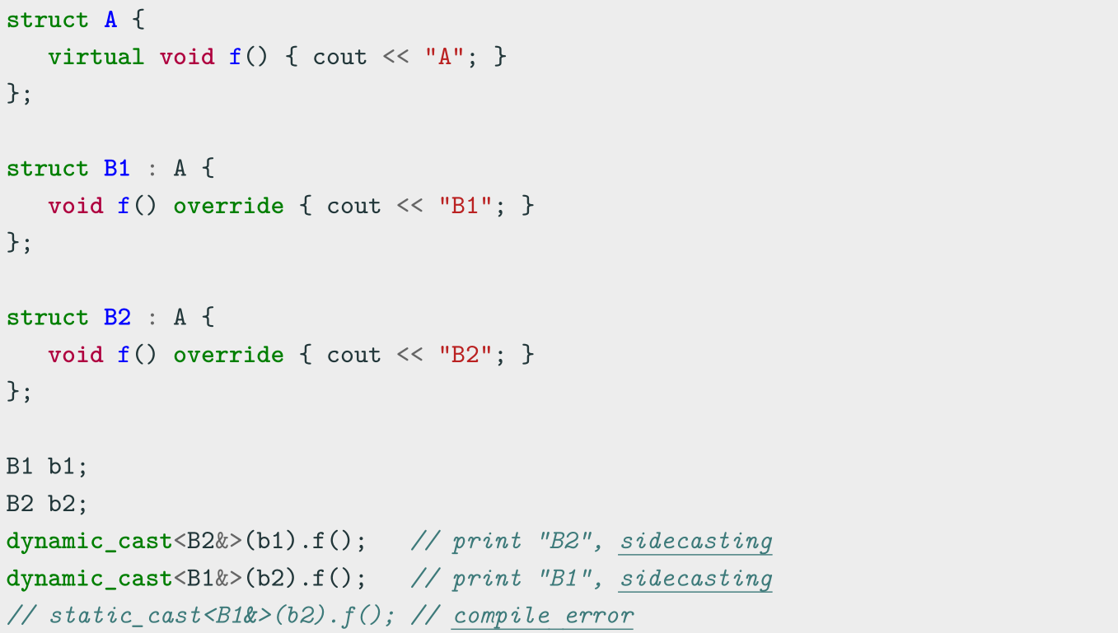
Sidecasting Example

Slide 6
Run-time Type Identification
RTTI
Run-Time Type Information (RTTI) is a mechanism that allows the type of an object to be determined at runtime
C++ expresses RTTI through three features:
• dynamic_cast keyword: conversion of polymorphic types
• typeid keyword: identifying the exact type of an object
• type_info class: type information returned by the typeid operator
RTTI is available only for classes that are polymorphic, which means they have at least
one virtual method

Slide 7
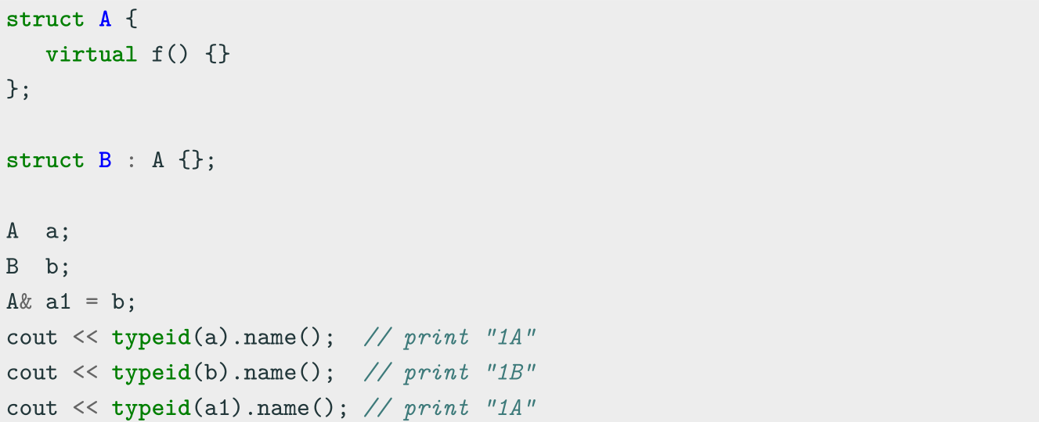
type info and typeid
type_info class has the method name() which returns the name of the type

Slide 8
dynamic cast
dynamic_cast , differently from static_cast , uses RTTI for deducing the
correctness of the output type
This operation happens at run-time and it is expensive
dynamic_cast<New>(Obj) has the following properties:
• Convert between a derived class Obj to a base class New → upcasting. New ,
Obj are both pointers or references
• Throw std::bad_cast if New , Obj is a reference ( T& ) and New , Obj
cannot be converted
• Returns NULL if New , Obj are pointers ( T* ) and New , Obj cannot be
converted

Slide 9
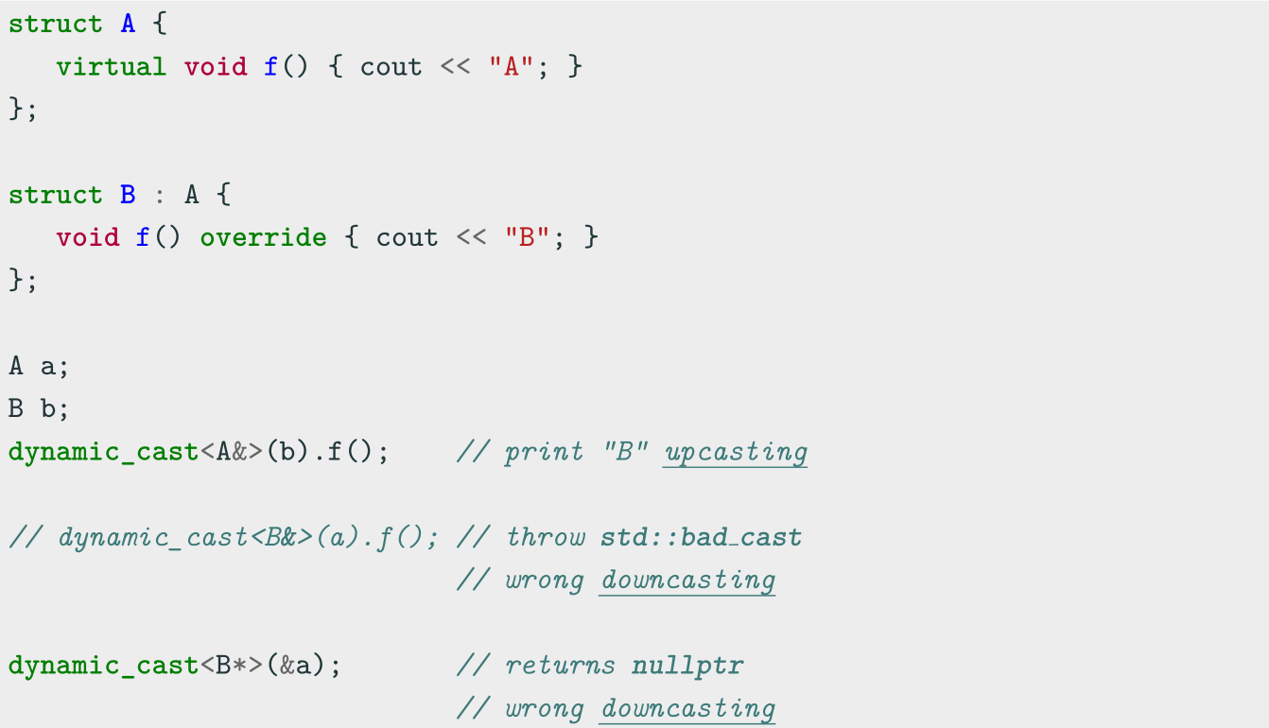
dynamic cast Example 1

Slide 10
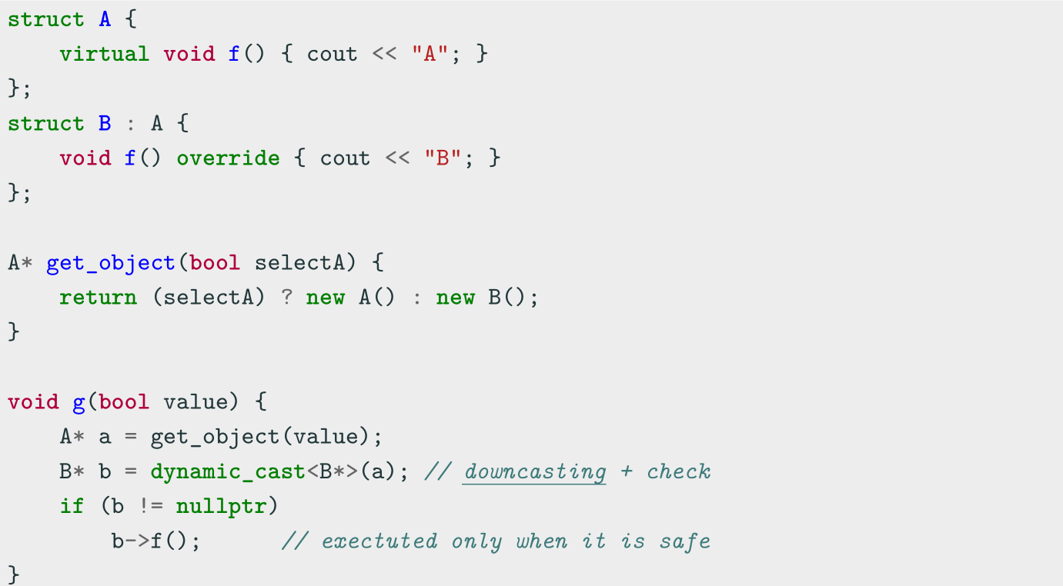
dynamic cast Example 2

Slide 11
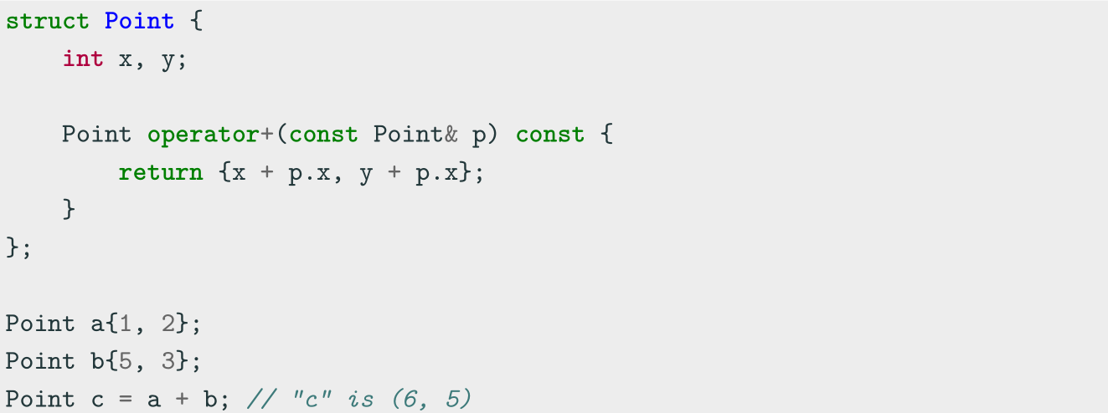
Operator Overloading
Operator Overloading
Operator overloading is a special case of polymorphism in which some operators are treated as polymorphic functions and have different behaviors depending on the type of its arguments

Slide 12
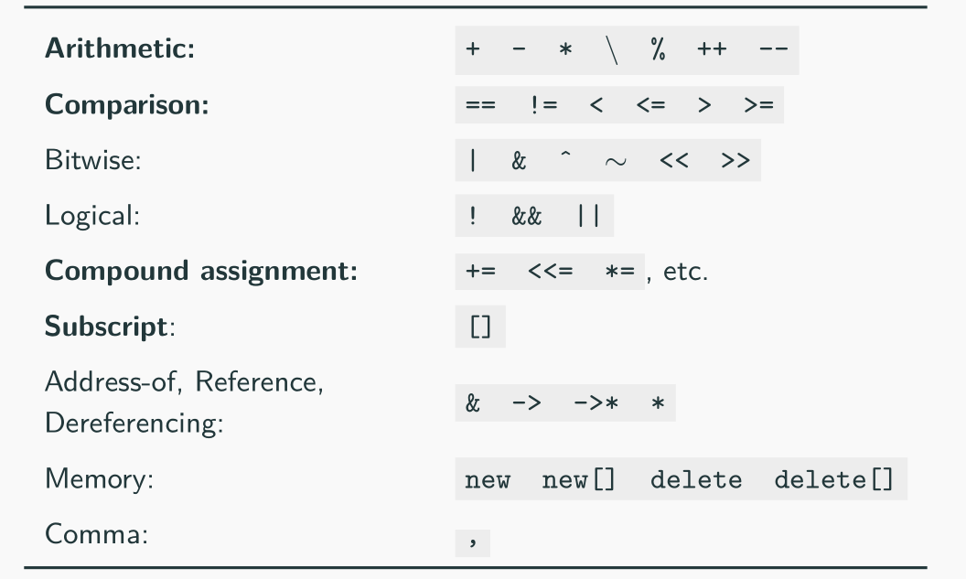
Operator Overloading
Categories not in bold are rarely used in practice
Operators which cannot be overloaded: ? . .* :: sizeof typeof

Slide 13
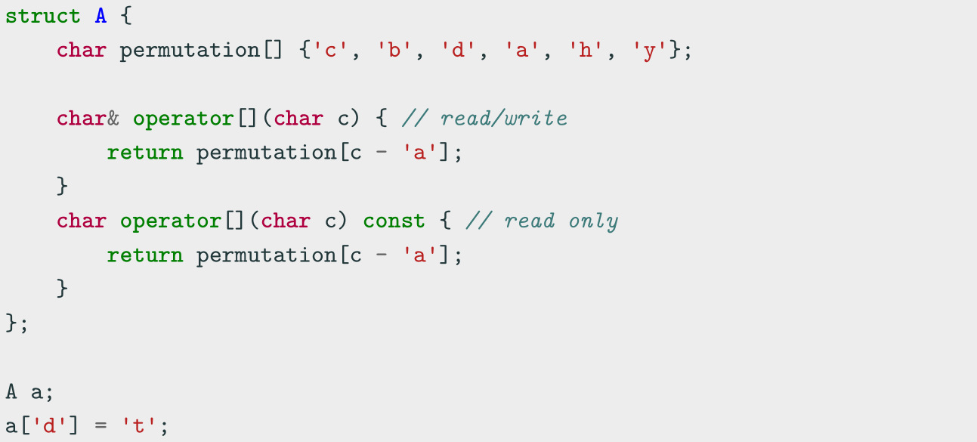
Subscript Operator operator[]
The array subscript operator[] allows accessing to an object in an array-like fashion
The operator accepts everything as parameter, not just integers

Slide 14
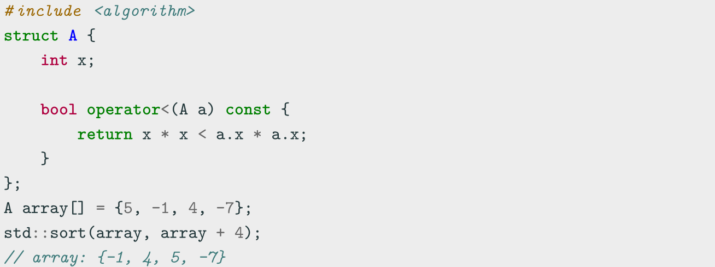
Comparison Operator operator<
Relational and comparison operators operator<, <=, ==, >= > are used for
comparing two objects
In particular, the operator< is used to determine the ordering of a set of objects
(e.g. sort)

Slide 15
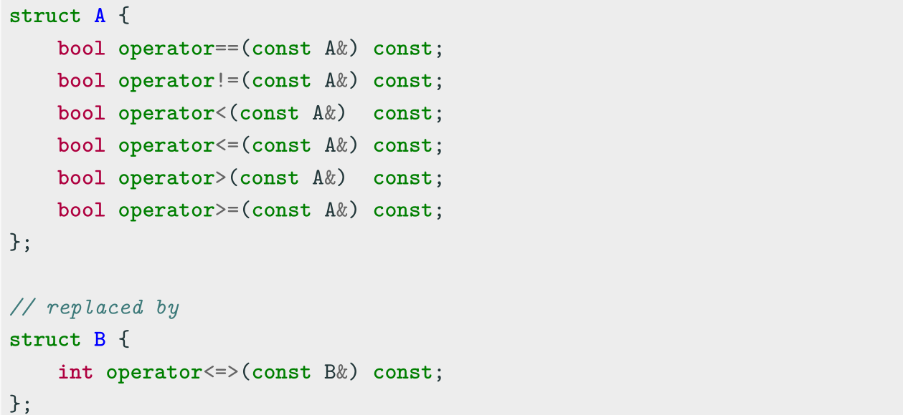
Spaceship Operator operator<=>
C++20 allows overloading the spaceship operator <=> for replacing all comparison
operators operator<, <=, ==, >= >

Slide 16
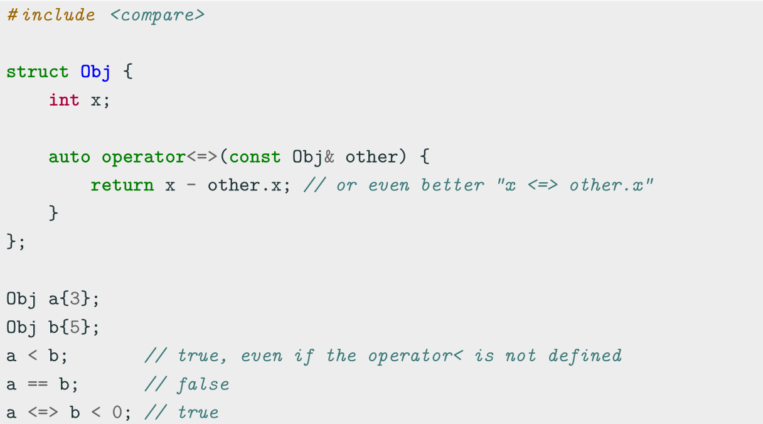
Spaceship Operator operator<=>

Slide 17
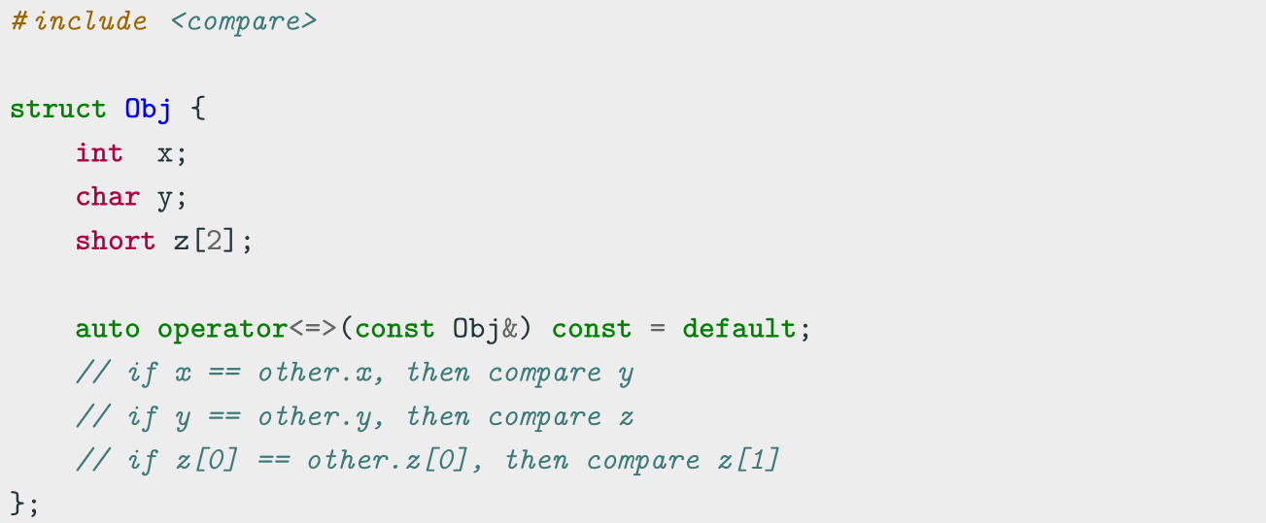
Spaceship Operator operator<=>
The compiler can also generates the code for the spaceship operator = default , even
for multiple fields and arrays, by using the default comparison semantic of its members

Slide 18
Spaceship Operator operator<=>
The spaceship operator can use one of the following ordering:
strong ordering • if a is equivalent to b , f(a) is also equivalent to f(b)
• exactly one of < , == , or > must be true
○ integral types, e.g. int , char
weak ordering • if a is equivalent to b , f(a) may not be equivalent to f(b)
• exactly one of < , == , or > must be true
○ rectangles, e.g. R{2, 5} == R{5, 2}
partial ordering • if a is equivalent to b , f(a) may not be equivalent to f(b)
• < , == , or > may all be false
○ floating-point float , e.g. NaN

Slide 19
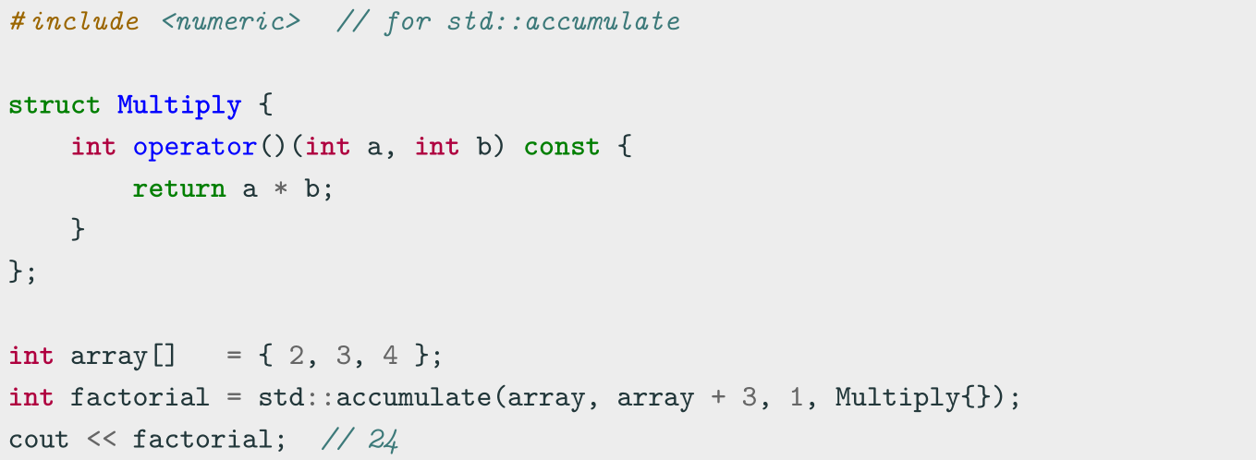
Function Call Operator operator()
The function call operator operator() is generally overloaded to create objects
which behave like functions, or for classes that have a primary operation (see Basic
Concepts IV lecture)

Slide 20
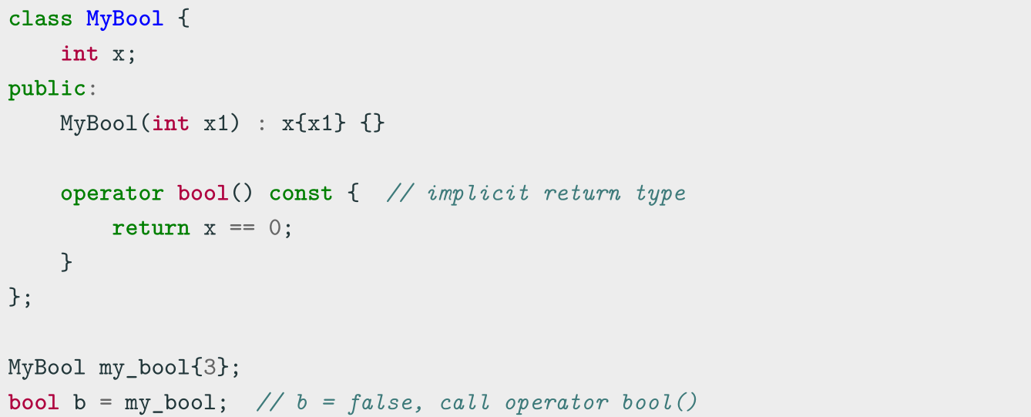
Conversion Operator operator T()
The conversion operator operator T() allows objects to be either implicitly or
explicitly (casting) converted to another type

Slide 21
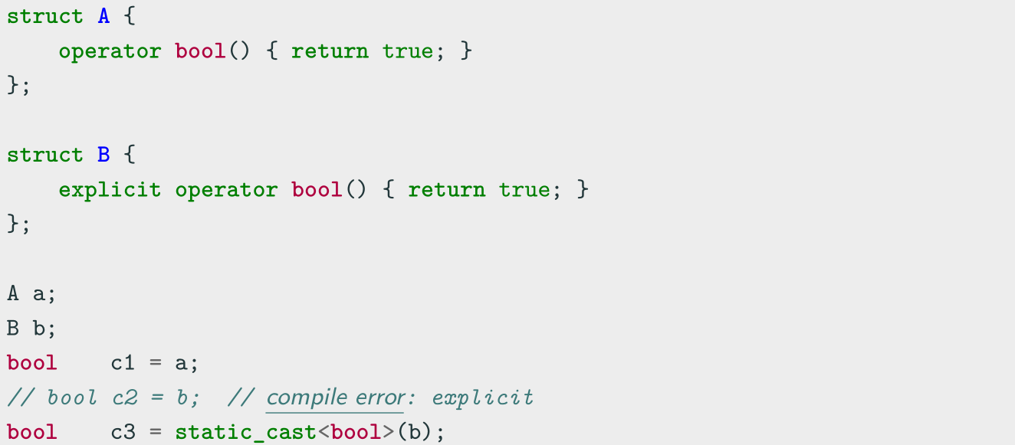
Conversion Operator operator T()
C++11 Conversion operators can be marked explicit to prevent implicit
conversions. It is a good practice as for class constructors

Slide 22
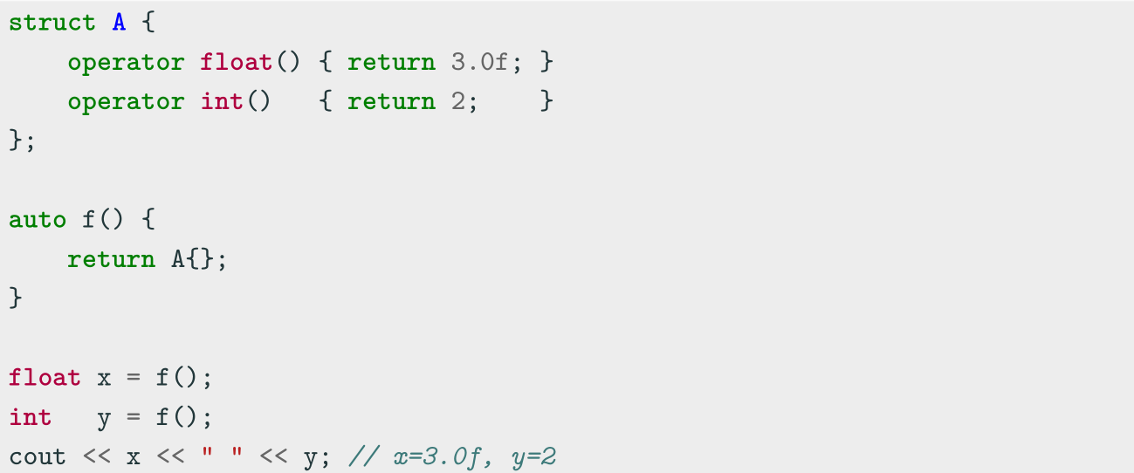
Return Type Overloading Resolution

Slide 23
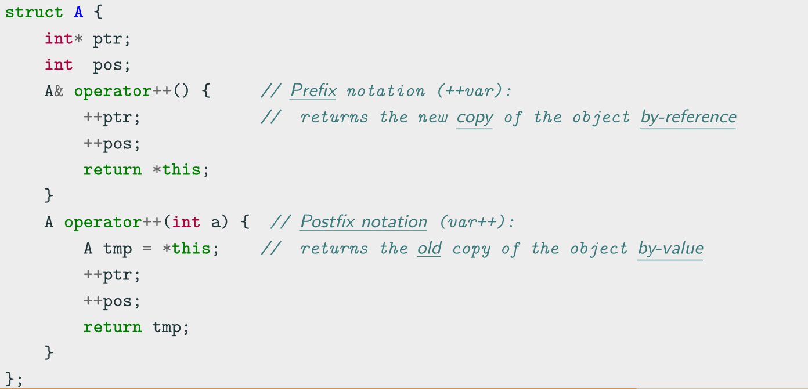
Increment and Decrement Operators operator++/--
The increment and decrement operators operator++, operator-- are used to update
the value of a variable by one unit

Slide 24
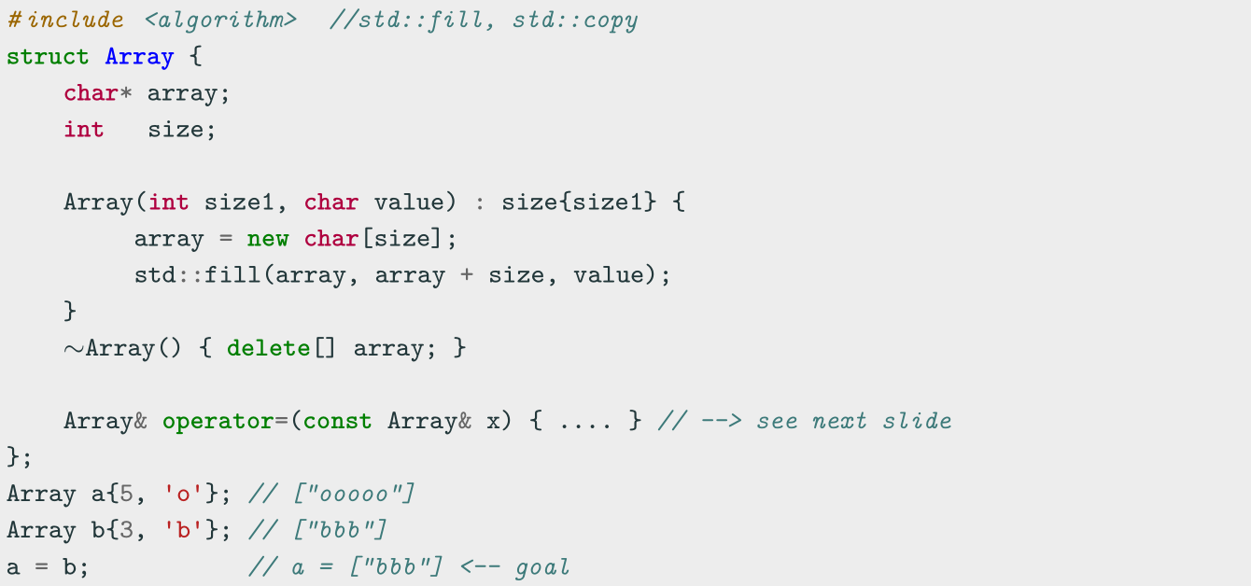
Assignment Operator operator=
The assignment operator operator= is used to copy values from one object to
another already existing object

Slide 25
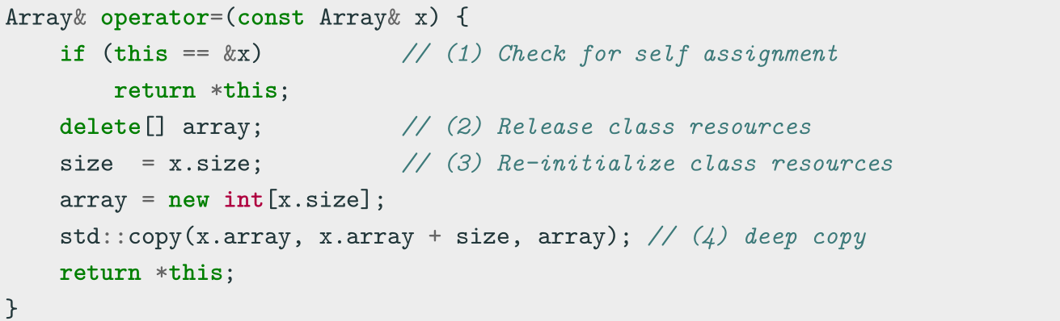
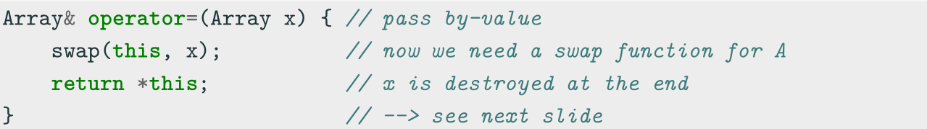
Assignment Operator operator=
First option:
Second option (less intuitive):

Slide 26
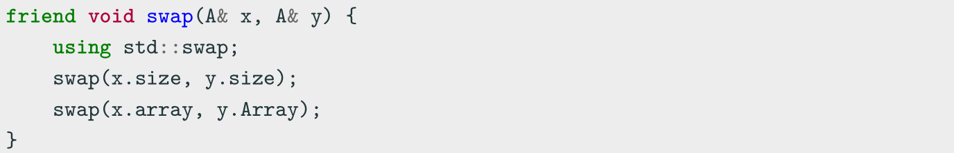
Assignment Operator operator=
swap method:
• why using std::swap ? if swap(x, y) finds a better match, it will use that instead of std::swap
• why friend ? it allows the function to be used from outside the structure/class scope

Slide 27
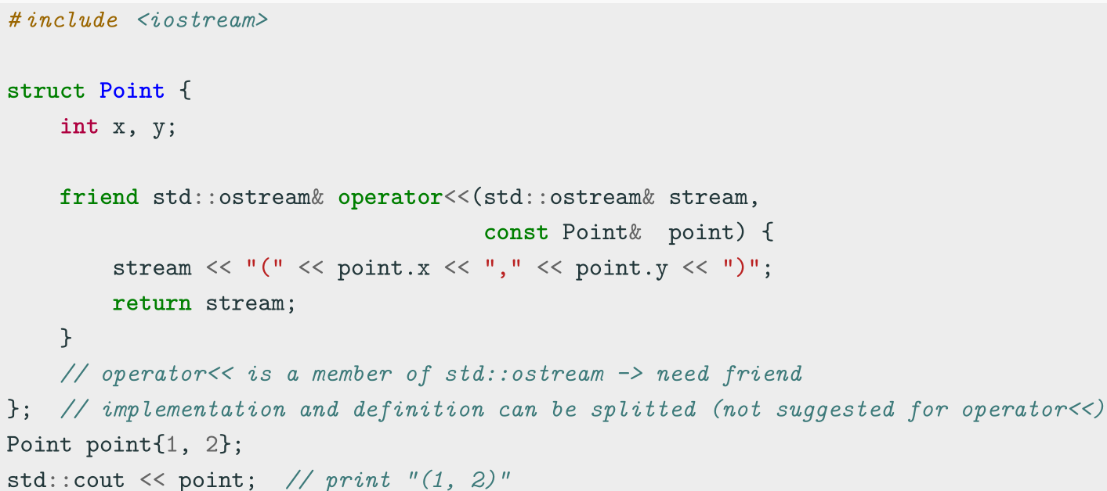
Stream Operator operator<<
The stream operation operator<< can be overloaded to perform input and output
for user-defined types

Slide 28
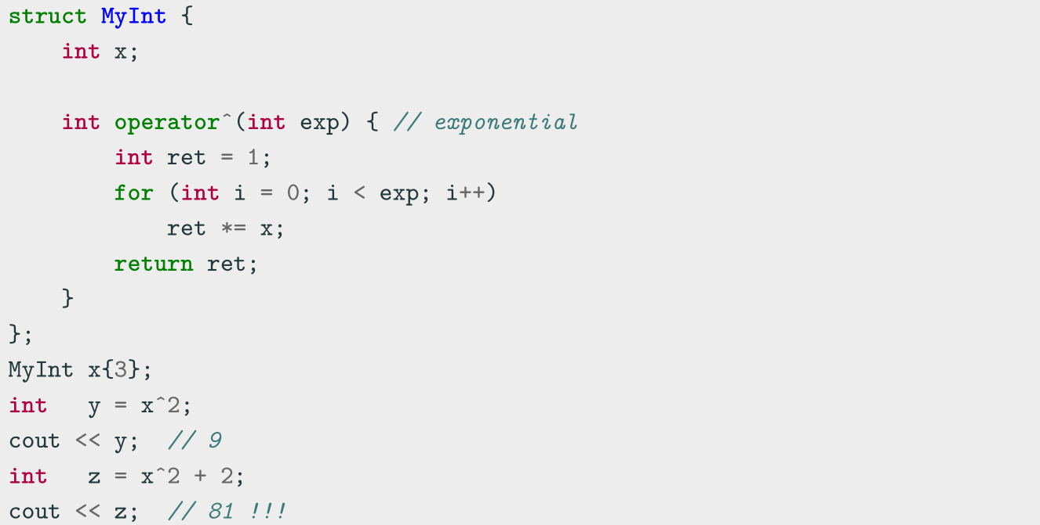
Operators Precedence

Slide 29
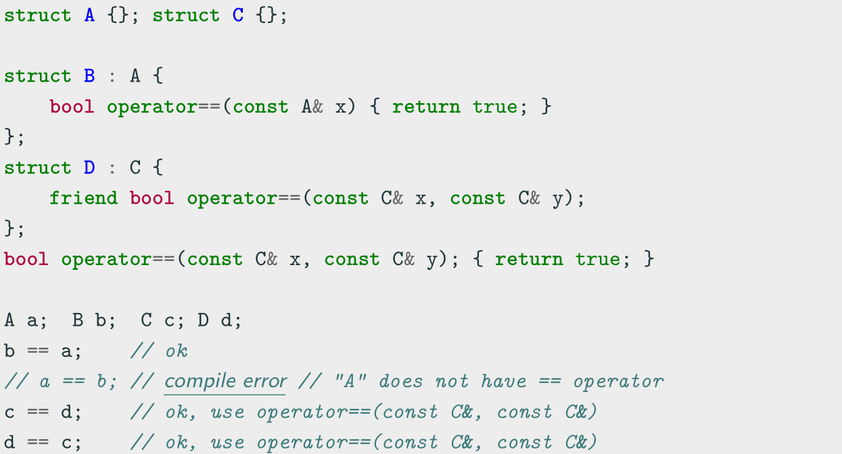
Binary Operators Note
Binary operators should be implemented as friend methods

Slide 30
Coding for love, Coding for the world
Qijun Zhao
qjzhao@scu.edu.cn

